Slide 1
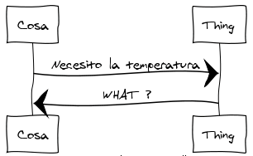

Semantic Interoperability for IoT
Jaime Jiménez
Senior Researcher SMN
IoT Research Days - Oct 2016

Slide 2
IoT Work at IETF
IETF’s role: Specify the underlying, fundamental Internet technologies
“Permissionless innovation” – people can build on top – unlike App Stores or Telco-oriented services.
Run <IoT transfer protocol> over IP | Security for IoT (ACE, COSE)
Routing for low power and lossy networks | Thing-to-Thing communication (IRTF)
Web Technology for IoT (CoRE) | Architectural oversight (IAB)
Notes:
IETF has been doing Internet standards for 30 years.
Its main tenet is to allow any individual or company to build their systems without having to ask for permission to install applications or control.
That message is very powerful because it settles on developers and has become a de-facto way of working. People assume open standards.
Without going much into details these two groups have been involved on most of the IoT Research on IETF.

Slide 3
Consolidation is moving up the stack
From closed, vertical solutions to open horizontal ones.
Alignment on using Internet protocols. Already done on the network layer (IP, IPv6) and happening on application protocols (HTTP, CoAP, MQTT) but not there yet on the semantics.
Many new consortia due to IoT hype.
Notes:
Vertical solutions are still there and are used by a majority of vendors. The approach they take is that of simple data mining from sensors.
However we see a bit of a shift from tailor-made solutions for very specific products to doing those same products thinking more long-term and with interoperability in mind.
To achieve that interoperability for very constrained devices a huge amount of work has been placed on enabling IP technologies on them first and on using same application protocols second.
Due to that consolidation of the protocol stack we see many consortia rising with different frameworks and systems that basically use standards with an additional Object Model on top. This might also be due to the IoT Hype so we should take those consortia with a grain of salt: fiat, corporate and personal standards are not the same and are not equally established. Even among standard organizations it is not the same thing whatever a consortia like OMA brings to the table than an Internet draft or RFC.

Slide 4
IAB - IOT Semantic Interoperability Workshop
March 2016
Why?
Consumers and other users want systems where they can acquire components from different manufacturers.
Ability to build larger systems out of components built by different companies and for different purposes will drive innovation.
Goals
Facilitate introductions between relevant organizations.
Identify opportunities for cross-organization collaboration by identifying similarities between models/systems.
Have some lasting impact after one-time event is over.
Why ?
Internet tech and neutrality.
Received 66 submissions (42 accepted): 17 standards organisations, vendors, operators, individuals and research organizations.
Notes:
In order to try to at least understand what is out there when it comes to the data models and the semantics of these different systems we (Ericsson) organized a workshop last march.
The main driver for the workshop is the acknowledgement by the community that users and consumers will need their devices to interoperate in the future and that they will be acquiring components from different manufacturers.
Another point of the event was to facilitate cooperation between organizations (at least to get to know the people implementing those different standards and models) and identify cross-organization collaboration possibilities.
IAB was chosen because it has a long tradition of tackling this type of large cross-domain issues and it is known because it takes a purely technical stand.
We got lots of good quality submissions from the main players in the industry and academia.

Slide 5

IAB - IOT Semantic Interoperability Workshop
“Please, no more standards”
Notes:
What was clear from the start is that we were not there to create a new standard, rather to start merging some and trying to find consensus.
In truth, when you come to analyze each of the different proposals, many were using old fashioned ways of interacting between devices or were sharing the same stack with different branding.
However when it came to data models they all pretty much disagreed both on the format and the content.

Slide 6
IOTSI Workshop takeaways
Interaction Models
REST vs PubSub vs RPC calls.
REST facilitates IoT evolution.
How and when to do translation
Multiple Data Models will have to coexists (at least for a while).
Lack of common terminology (IM, DM, etc).
Translation Hubs: Runtime translation of data vs Translating DMs.
Loss of information when translating data models.
How to deal with change
Multiprotocol not an option for most constrained devices. Legacy is heavy.
Need to build systems that last. Web approach.
Hypermedia Applications vs “REST” static APIs vs Pushing Binaries.
Notes:
One of the clearest outcomes to me was that of the various interaction models REST was vastly superior and adaptable than the others. This was apparent for those coming with a web-oriented background but those accustomed to RPC type of communication or publish subscribe find it hard to accept. Mostly because REST is a bit harder to understand than it seems.
Another outcome was about the need for translation. It seems that for some time there will be multiple data models that will have to coexist and be translated to one another. The lack of common terminology and concepts was even more apparent, which made the already “fuzzy” area of Semantics even more fuzzy. When deciding about translation it is important also to distinguish between real time translation of a payload into another (as it is done by proxies) vs translating data models themselves, which would be a one-time thing.
Last and most important was the need to deal with change. Many of the existing systems are dragging innovation because multiprotocol HAS to be supported for legacy systems. This is just not a desirable feature in the long term and it is just not possible for really constrained devices. Therefore we need to build systems that last for decades or even centuries, and that’s where the current internet and web infrastructure has the largest legacy. While the approach towards a web-like IoT is definitely happening (IP, CoAP) there is still a lot of misconceptions.

Slide 7
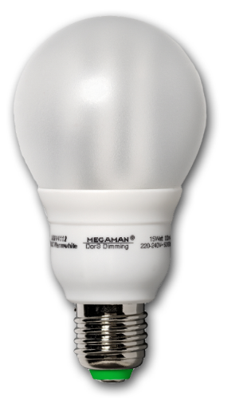
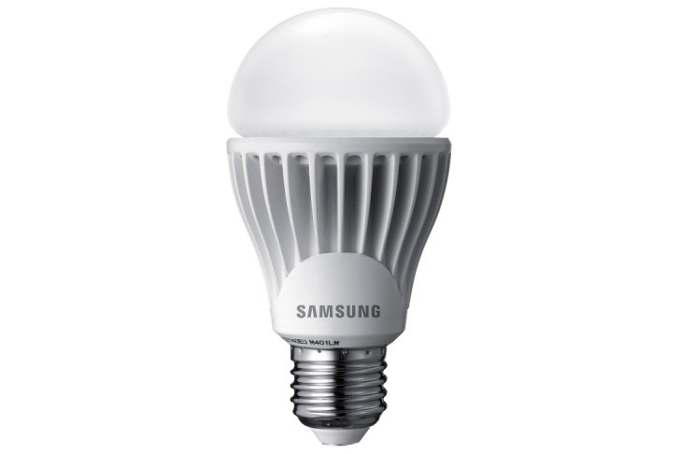

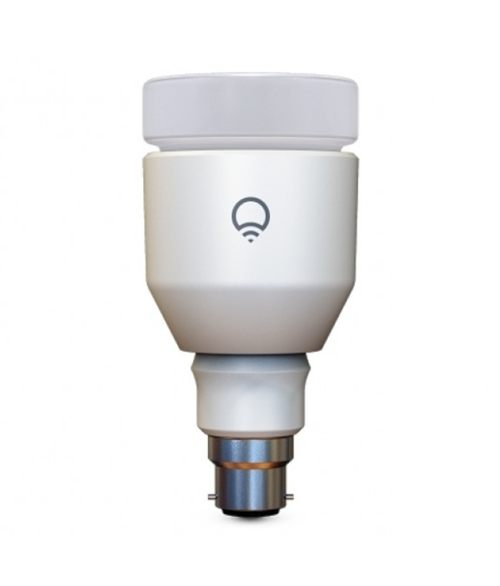
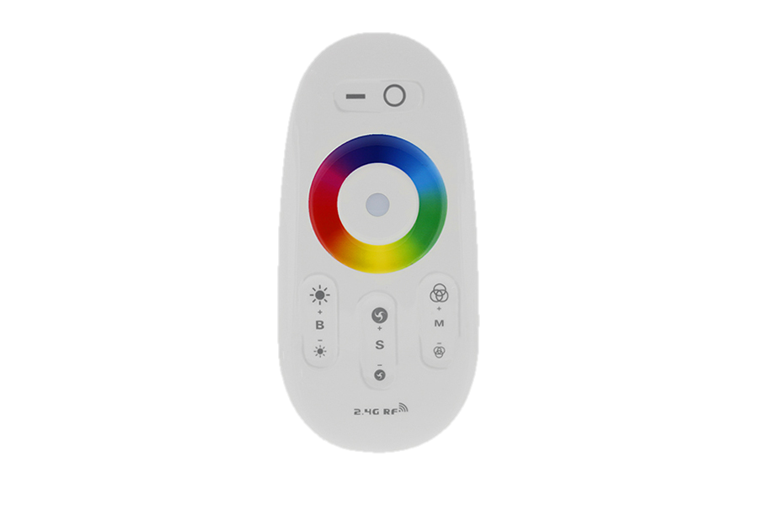
Ability to deal with change
✓ Agreed Data Model
(IPSO, OCF, W3C…)
✗ Changing requirements, devices, capabilities…
1. Control alternative things
4. Also control future things
with older things
3. Still control old things
✗ Broken APIs
2. Add new things
✓ Using Discovery mechanism
(CoAP RD, MQTT Broker…)
Source: M. Kovatsch
Notes:
Dealing with change means being able to control alternative things with the same type of protocols and communication patterns. And at this point we can already do that providing there is some agreement on the data model and protocol to be used.
Devices themselves need to be able to find new things without the need for user configuration. That is already achieved by current technologies.
We still need to be able to control old things later in the future when protocols and models evolve. This has proven already to fail due to the static nature of some Web APIs.
Moreover we also need to control future things we things that we deploy today. This we see fail constantly too, for similar reasons, that’s why we need software updates, v0.0 etc on every single device.

Slide 8
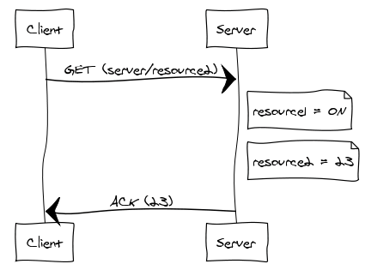
REST interaction components for IoT (roughly)
Browser / Other IoT Device
(consumer / servient)
IoT Device
Resource URI
(where)
Resources
(things we interact with)
Method
(what we do)
Present: Value representation
(current measurement)
Future: Hypermedia
(what happens next?)
Notes:
First of all we have two things, two devices like a switch and a lightbulb or a browser or application and a temperature sensor. They are also called endpoints. For every interaction or transaction, there will be one endpoint consuming information and the other one serving it.
Where that information is located is represented by a URL (you know, like www.ericsson.com), every person knows that URLs are typed on the address bar of the browser, with machines is a bit different but the same principle.
The server side is a sensor too, a CoAP server. This is a common misconception from people that think of constrained devices only as clients. Actually they will usually be both (that is called servient). The server hosts resources, that are acted upon using some method (GET in this case). Both client and server are developed independently, often by different companies (just like your firefox browser and the ericsson.com portal is developed by different people). If the server is working properly it will send back the resource representation as well as the appropriate response code.
Now, IoT Semantics is about HOW is that resource representation describes the resource state and is understood by the client, also about which information needs to be shared a priori and about how would the application understand it. At the beginning the resource representation was just a value, let’s say an integer but it could grow to be just as large as an HTML document (which is the one used on the web).
However the future of IoT REST interactions is all about Hypermedia Applications.

Slide 9
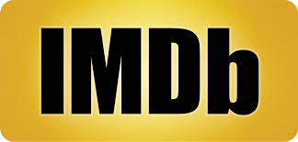
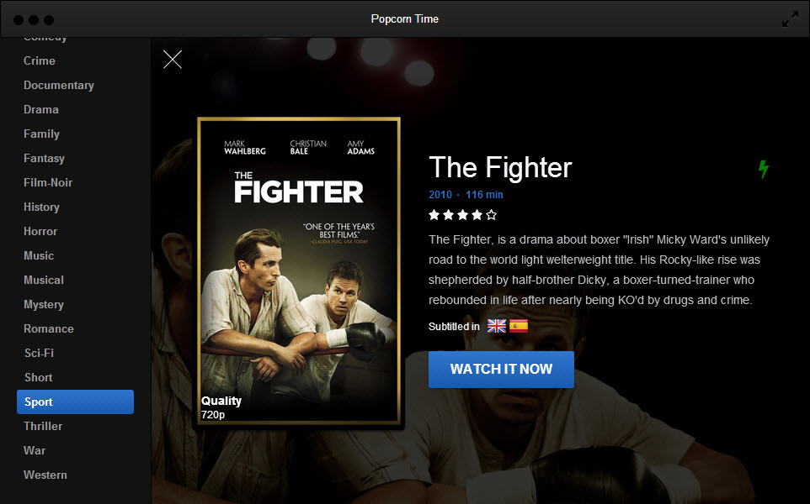




The power of mashups
Internal microservice APIs
Notes:
REST and the Web has been working very well for a long time.
It is build on standards, some of them extremely well-established and used by everyone like HTTP or HTML, and others are more of a one-way communication associated with a specific company. Like the twitter, facebook or google APIs.
Lately web mashups and scraping are a very powerful concept indeed, the example here is Popcorn time. This was built as a real time video streaming by some students in few months. The team that developed this was of some Argentinian university students over the span of “few weeks”. It was dropped due to copyright BUT the service created as an outcome was in many ways technically superior to others like Netflix for example.

Slide 10
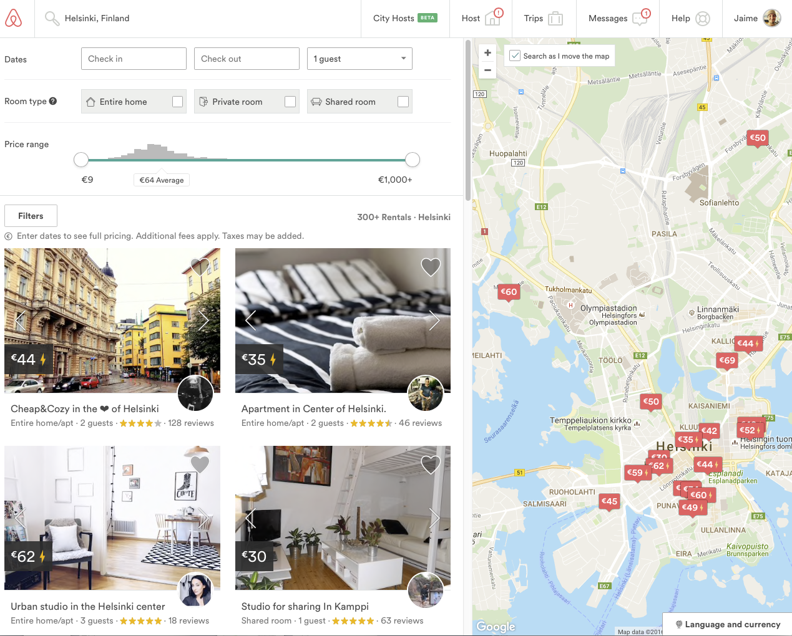





Web Mashups through Open APIs…
Internal microservice APIs
Notes:
Using Open APIs is indeed very common nowadays as most websites integrate different microservice APIs from which they build extra functionality.
However this APIs change over time and often break. If Airbnb tomorrow changes the API and their interface probably I won’t have any noticeable issues since humans can see and understand that change. However if you have another application that uses Airbnbs data, that application will break.

Slide 11
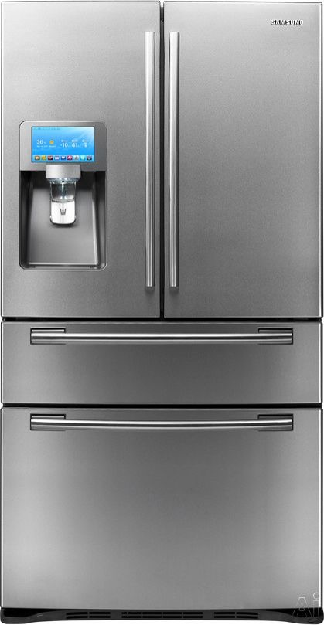
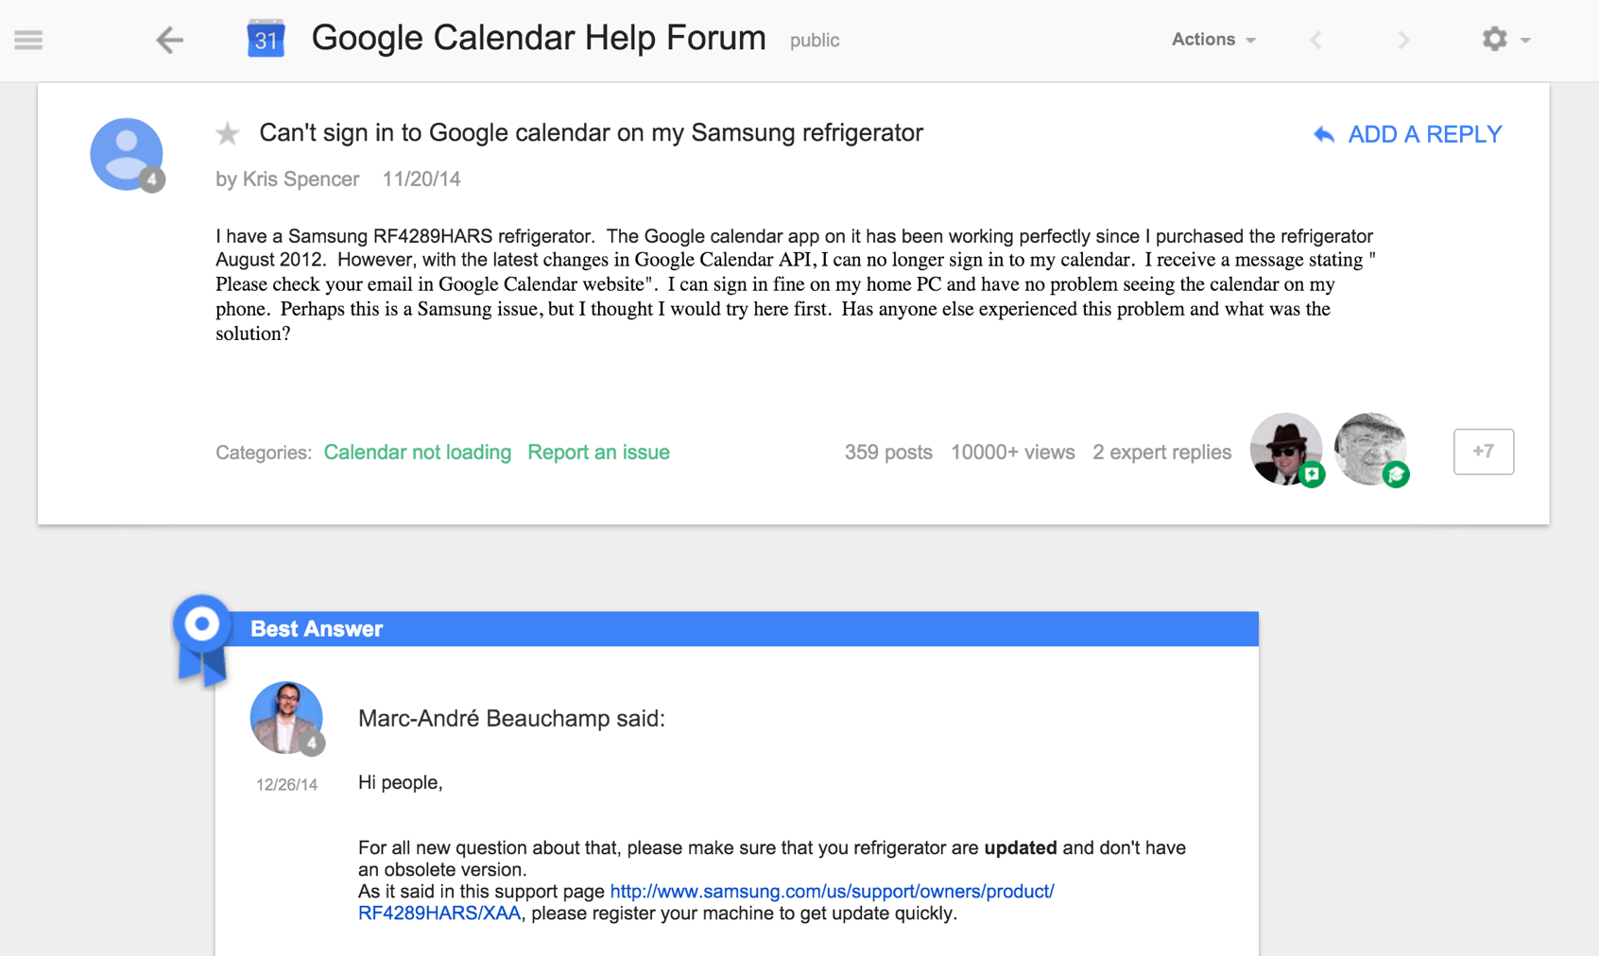
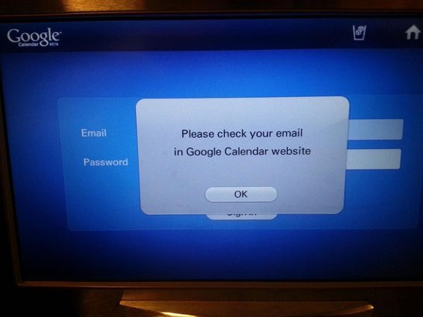
… often break
Notes:
And that is already happening on IoT. This case for example is this Samsung fridge, it became useless when Google changed their calendar API, since the fridge no longer could understand it. Refrigerators usually last about 14 years, a lifespan that has held pretty constant in the last few decades. But now with IoT the span might be shorter due to poorly designed REST APIs.
Indeed APIs are not (quite) the web. When a human is making all the decisions he gets to see all possible transactions and gets to choose. Without that the programmer has to create a software capable of making those decisions, effectively rising the entry barrier for hypermedia interactions.
Building true hypermedia
It is not enough that it does not break but it has also to be able to evolve.

Slide 12
Hypermedia-driven Applications (HATEOAS)
Client
Entry URI
Thing C
Submit forms
Action Result
Resource Directory
Follow links
Thing A
Choice &
redundancy
Thing B
Thing D
Dynamically extend process flow
Auth-Server
Source: M. Kovatsch
Notes:
Hypermedia As The Engine Of Application State
The concept is about modeling the application with atomic interaction steps (request-response). Requests are formulated using links and forms.
Relation type vocabulary attaches meaning, that vocabulary has to be already shared. Publication of links and forms allows for change (URIs shared at runtime)
Composition of multiple resources shape things and processes
Atomic interactions are described in-band and shape application
Loose Coupling, both servers and clients can evolve independently and clients can learn applications on the fly, for example we can dynamically extend an auth server.
This is already an improvement over current IoT systems. Even if you are using for example LWM2M and IPSO objects, you still need to send firmware upgrades every now and then because something has broken or because something has changed.
The future challenge on building Web APIs, specially for IoT Systems is on the semantics bridging the gap between understanding the semantic structure of a document and understanding what it means. Just like when your browser receives an HTML site representation and you, the human chooses what to do next.

Slide 13
W3C Thing Description (TD) Example
{
"@context": [
"http://w3c.github.io/wot/w3c-wot-td-context.jsonld",
{ "actuator": "http://example.org/actuator#" }
],
"@type": "Thing",
"name": "MyLEDThing",
"uris": [
"coap://myled.example.com:5683/",
"http://mything.example.com:8080/myled/"
],
"encodings": ["JSON", "EXI"],
"security": {
"cat": "token:jwt",
"alg": "HS256",
"as": "https://authority-issuing.example.org"
},
"properties": [
{
"@type": "actuator:onOffStatus",
"name": "status",
"valueType": { "type": "boolean" },
"writable": true,
"hrefs": [ "pwr", "status" ]
}
],
"actions": [
{
"@type": "actuator:fadeIn",
"name": "fadeIn",
"inputData": {
"valueType": { "type": "integer" },
"actuator:unit": "actuator:ms"
},
"hrefs": [ "in", "led/in" ]
},
"events": [
{
"@type": "actuator:alert",
"name": "criticalCondition",
"valueType": { "type": "string" },
"hrefs": [ "ev", "alert" ]
}
]
}
Notes:
W3C and others have started work on that, I will use W3C as an example because IMO it has gotten the farthest so far. Also because they built the main representation format existing out there today, HTML.

Slide 14
{
"@context": [
"http://w3c.github.io/wot/w3c-wot-td-context.jsonld",
{ "actuator": "http://example.org/actuator#" }
],
"@type": "Thing",
"name": "MyLEDThing",
"uris": [
"coap://myled.example.com:5683/",
"http://mything.example.com:8080/myled/"
],
"encodings": ["JSON", "EXI"],
"security": {
"cat": "token:jwt",
"alg": "HS256",
"as": "https://authority-issuing.example.org"
},
"properties": [
{
"@type": "actuator:onOffStatus",
"name": "status",
"valueType": { "type": "boolean" },
"writable": true,
"hrefs": [ "pwr", "status" ]
}
],
"actions": [
{
"@type": "actuator:fadeIn",
"name": "fadeIn",
"inputData": {
"valueType": { "type": "integer" },
"actuator:unit": "actuator:ms"
},
"hrefs": [ "in", "led/in" ]
},
"events": [
{
"@type": "actuator:alert",
"name": "criticalCondition",
"valueType": { "type": "string" },
"hrefs": [ "ev", "alert" ]
}
]
}
Property
Interaction Resources
Action
Event

Slide 15

Thanks & Links
IOTSI Workshop | https://www.iab.org/activities/workshops/iotsi/
IPSO | http://ipso-alliance.github.io/pub/
LWM2M | https://github.com/OpenMobileAlliance/
W3C Interest Group | https://www.w3.org/WoT/IG/
OneIoTA | http://www.oneiota.org/
REST | https://www.ics.uci.edu/~fielding/pubs/dissertation/rest_arch_style.htm
RESTful Web Apis | http://restfulwebapis.com
CoRAL | https://tools.ietf.org/html/draft-hartke-t2trg-coral-00
HSML | https://tools.ietf.org/html/draft-koster-t2trg-hsml-00
CoAP | https://tools.ietf.org/html/rfc7252
CoRE Link-Format | https://tools.ietf.org/html/rfc6690
CoRE RD | https://datatracker.ietf.org/doc/draft-ietf-core-resource-directory/
Data Models
REST
Hypermedia
Application
Languages
CoAP
@jaim jaimejim.github.io

